Slide 1
Experimental Loop Antenna for 40m
Colin Berry
M0GXV

Slide 2
Contents
What is a 'magnetic' loop?
Why build one?
But...
Practical project
Theory
Modelling Techniques
Performance
Going further

Slide 3
What is a 'Magnetic' Loop?
Small enough to be a 'circuit'
Big enough to have a phase difference
Capacitor tuned
Loosely coupled
Strong magnetic near-field
Dipole
Loop
Near field

Slide 4
Why Build One?
Experimentation / learning
Indoor / hidden
Scrapheap challenge
Compact and portable
No RF earth needed
Local E - qrm insensitivity
Multi-band tunable
Re-orientable

Slide 5
But...
Difficult to tune / narrow bandwidth
Tuned at antenna, not ATU
Low efficiency
Local B - qrm sensitivity
High local B field - interference
Plumbing skills needed
Set-up equipment required
High power needs an expensive capacitor

Slide 6
Practical Project
Pipework
Capacitor
Coupling
Mounting
Tuning

Slide 7
Theory
Radiation and near field
Efficiency
Inductor
Capacitor
Coupling

Slide 8
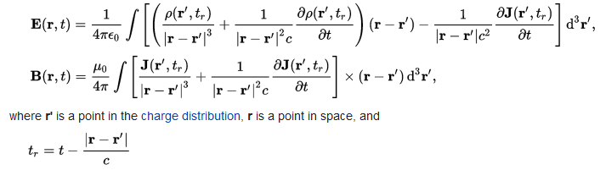
Electric/Magnetic Fields
Jefimenko's equations

Slide 9
Equivalent Model
Anti-phase dipoles – same 'area' & phase
Receives changing magnetic field
Current
observation
r
Current
l

Slide 10
Local magnetic field strengths

Slide 11
Efficiency
Radiation: Charge acceleration * phase difference factor
Radiation resistance = (power radiated) / current²
  ∝ (radius/wavelength)⁴
  Compare with short dipole, ∝ (length/wavelength)²
Extra loss resistance from:
  Skin resistance
  Dielectric (if any)
  Connections
  Near field absorption
Efficiency = radiation resistance / total resistance
Q, bandwidth and efficiency are related

Slide 12
Bandwidth, Q and Efficiency
Unloaded Q = reactance / resistance
When matched receiver connected, loaded Q is half this
Receiver bandwidth between -3dB points = frequency / loaded Q
Pure radiation resistance: 0.015Ω
  unloaded Q 11000, SWR < 1.5 over 0.3 kHz
Efficiency reduced by actual Q / pure Q

Slide 13
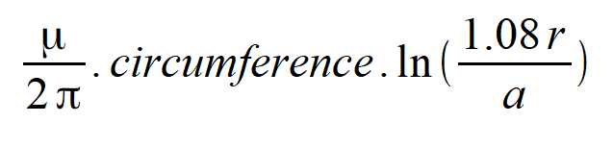
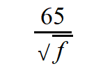
Theory - Inductor
Inductance of a loop:
Skin depth (microns):
At 7MHz : 150j Ω + 0.06 Ω + joints
  For 15mm diameter copper pipe
Can add extra turns for low frequency use

Slide 14
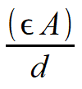
Theory - Capacitor
Parallel plate capacitance:
LDPE dielectric:
  Relative permittivity 2.2
  Loss resistance: reactance x 0.0003 (PVC is 0.01)
0.3mm “picture frame” spacer adds ~ 50% to capacitance
Loop has some capacitance too

Slide 15
Theory – Coupling
Separate loop acts as transformer
Adjust to match loop resistance → 50Ω
Series capacitor neutralises self inductance
  Used length of microphone coax cable
  Alternative to using ATU
Alternatives
  Tiny capacitor, off-tuning
  Gamma match

Slide 16
Tuning
Neutralise coupling inductance
Tune main loop
  Course tuning – grid dip oscillator or antenna analyser
  Fine tuning – Tx + absoption wavemeter, or antenna analyser
Adjust coupling loop spacing or ATU to match to transmitter
Measure bandwidth, deduce Q
Determine maximum drive power (and ERP)

Slide 17
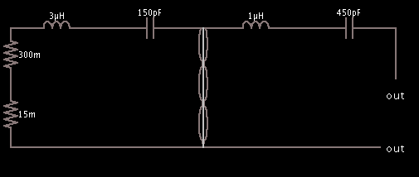
Modelling Techniques
Equivalent circuit – coupled resonators
Standard loop calculations
aa5tb_loop_v1.22a
Complex number maths in spreadsheets
  SWR vs bandwidth
  C:\Users\Colin\Documents\magloop mutual coupling.ods
NEC simulation

Slide 18
Performance
Receiver bandwidth around 25kHz
  Loss resistance 0.5Ω
  Effective unloaded Q around 500
Efficiency 5% (-13dB vs perfect dipole)
SWR < 1.5 over 10kHz
Power limit? Predicted 25W input, 1W ERP
On 40m : SSB QSO to GB1RR Nottingham

Slide 19
Going Further
Next steps in project
  Additional variable capacitor for fine tuning
  Mount on pole
  Investigations into unexplained losses
Alternative approaches
  Different loop materials / number of turns / thickness
  High voltage variable capacitor with motor drive
    Vacuum capacitor is best but expensive
Commercial loops
  MFJ 1788X at £530
  Www.wimo.com - up to €1500
Constructional articles
  RadCom December 2015
  many photos and articles on internet

